Slide 1


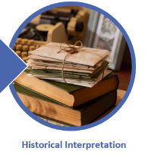
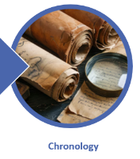
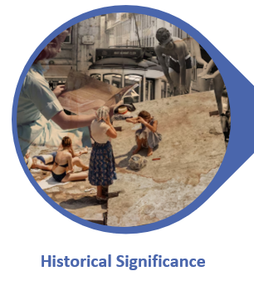


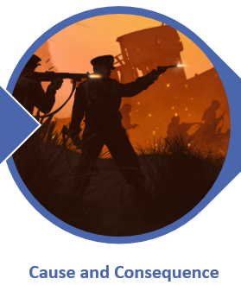
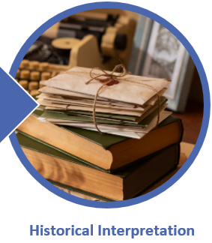
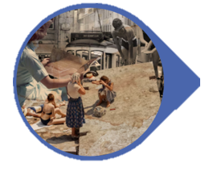

1. History
First, we are going to immerse ourselves in what we understand power to be and be introduced to the British Empire and the Victorian period.
Uses sources of information form testable hypotheses about the past. Analyse a wide range of evidence to justify claims about the past. Understand that no single source of evidence gives the full answer to questions about the past.
2. History/Geography
Then we will look at how Britain changed over the Victorian period: from a rural society to an urban one. We will explore the land use patterns and how they have changed over time.
Identify and describe periods of rapid change in history and contrast them with times of relatively little change. Name and locate cities of the United Kingdom and understand how their identifying human and physical characteristics and land-use patterns have changed over time.
3. History
Then we will visit Kelham Island Museum, where we will explore the history and importance of Sheffield in the Industrial Revolution.
Describe the characteristic features of the past, including ideas, beliefs, attitudes and experiences of men, women and children.
Power and Governance
What does it mean to be powerful?
Key concepts: consider questions of power and privilege and critically think about reasons why history is interpreted in different ways.
Purpose: To create a display about Power and Governance
4. History
Then we will look at power within Victorian Britain and the difference between certain classes and how this affected how people lived. We can compare things to today.
Describe the characteristic features of the past, including ideas, beliefs, attitudes and experiences of men, women and children. Refine lines of enquiry as appropriate.
6. Geography/History
We will then look at Queen Victoria’s power within other countries under British rule, focusing on India.
Describe the main changes in a period of history and understand economic activity including trade links, and the distribution of natural resources.
5. Geography/History
Next, we will learn in more detail about the British Empire and its power over the world. Looking at maps and geographical features.
Give a broad overview of life in Britain and some major events from the rest of the world. Identify the significance of latitude, longitude, Equator, Northern Hemisphere, Southern Hemisphere, the Tropics of Cancer and Capricorn, Arctic and Antarctic Circle, the Prime/Greenwich Meridian and time zones.

