Slide 1
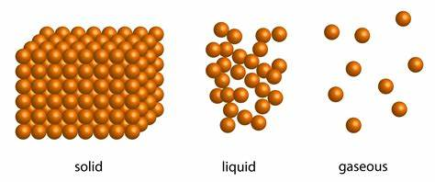
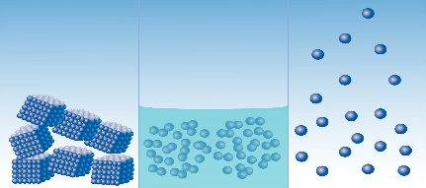
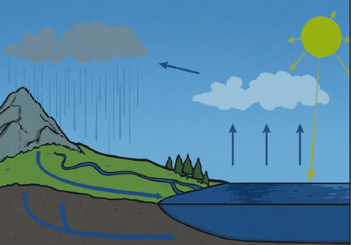
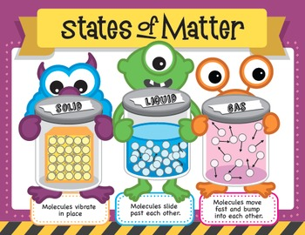
Knowledge Organiser: States of Matter
Key Vocabulary
States of matter | Materials can be one of the three states: solids, liquids or gases. Some materials can change from one state to another and back again.
Solids | These are materials that keep their shape unless a force is applied to them. They can be hard, soft or even squashy. Solids take up the same amount of space no matter what has happened to them.
Liquids | Liquids take the shape of their container. They can change the amount of space they take up. They can flow or be poured.
Gases | Gases can spread out to completely fill the container or room they are in. They do not have any fixed shape but they do have a mass.
Water vapour | This is water that takes the form of a gas. When water is boiled, it evaporates into a water vapour.
Precipitation | Liquid or solid particles that fall from a cloud as rain, sleet, hail or snow.
Key Facts
Condensation is when water vapour is cooled down and turns into water. You can see this when droplets of water form on a window. The water vapour in the air cools when it touches the cold surface.
Water expands by 9% when it freezes.
Compound gases, like carbon dioxide (CO2), are made up of more than one particle.
Evaporation occurs when water turns into water vapour. This happens very quickly when the water is hot, like in a kettle, but it can also happen slowly, like a puddle evaporating in the warm air.
97% of the water on earth is salt water and 2% is stored in ice and glaciers.
Did you know?
Humans are made of all three main states of matter.

