Slide 1

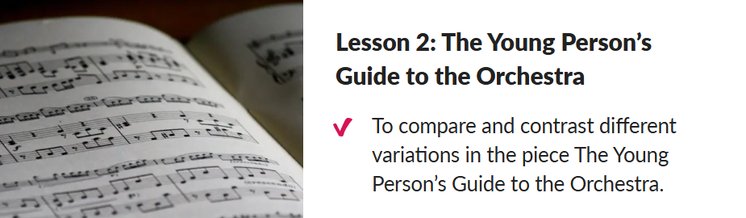



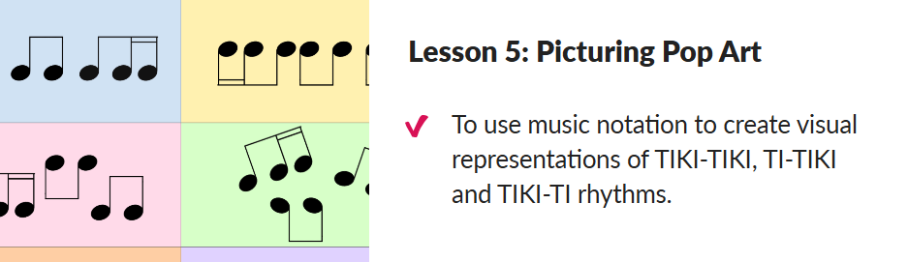
Key Concepts:
To know that a ‘theme’ is a main melody in a piece of music.
To know that ‘variations’ in music are when a main melody is changed in some way throughout the piece.
To know that ‘The Young Person’s Guide to the Orchestra’ was written in 1945 by Benjamin Britten.
To understand that representing beats of silence or ‘rests’ in written music is important as it helps us play rhythms correctly.
Key Skills:
Representing changes in pitch, dynamics and texture using graphic notation, justifying their choices with reference to musical vocabulary.
Identifying the way that features of a song can complement one another to create a coherent overall effect.
Use musical vocabulary correctly when describing and evaluating the features of a piece of music.
Vocabulary
3/4 time
4/4 time
orchestra
percussion
pitch
tempo
Year 6 Spring 2: Theme and Variations
Pop Art

