Slide 1
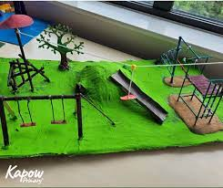
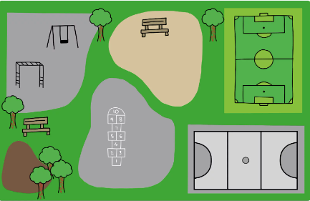
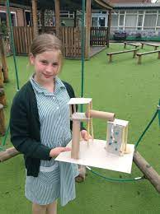
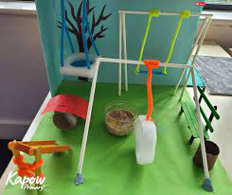
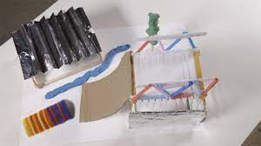
Lesson 1
We will look at given design criteria to create our own design for a playground. We will consider whether to use a theme, put in 5 pieces of apparatus and consider which landscape features may be appropriate.
Lesson 2
Next we will build three of the structures from our designs. We will consider how to measure, mark and then cut pieces. Then we will think carefully how to glue different pieces together.
Year 6:
DT: Structures
Playgrounds
Lesson 4
Next we will consider the landscape that they playground will be in and think about its impact on the environment and its users. Using collected natural items we will make the landscape and attach our structures to our playgrounds.
Lesson 3
We will perfect our structures and add cladding to some of them. Think carefully about joining techniques and relevant safety precautions.
Outcome:
To create five apparatus designs which match the given criteria.
To make roughly three different structures from their plans using the materials available
To review and improve their structures.

