Slide 1
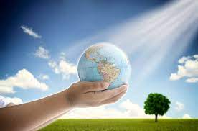
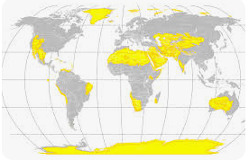
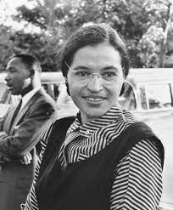
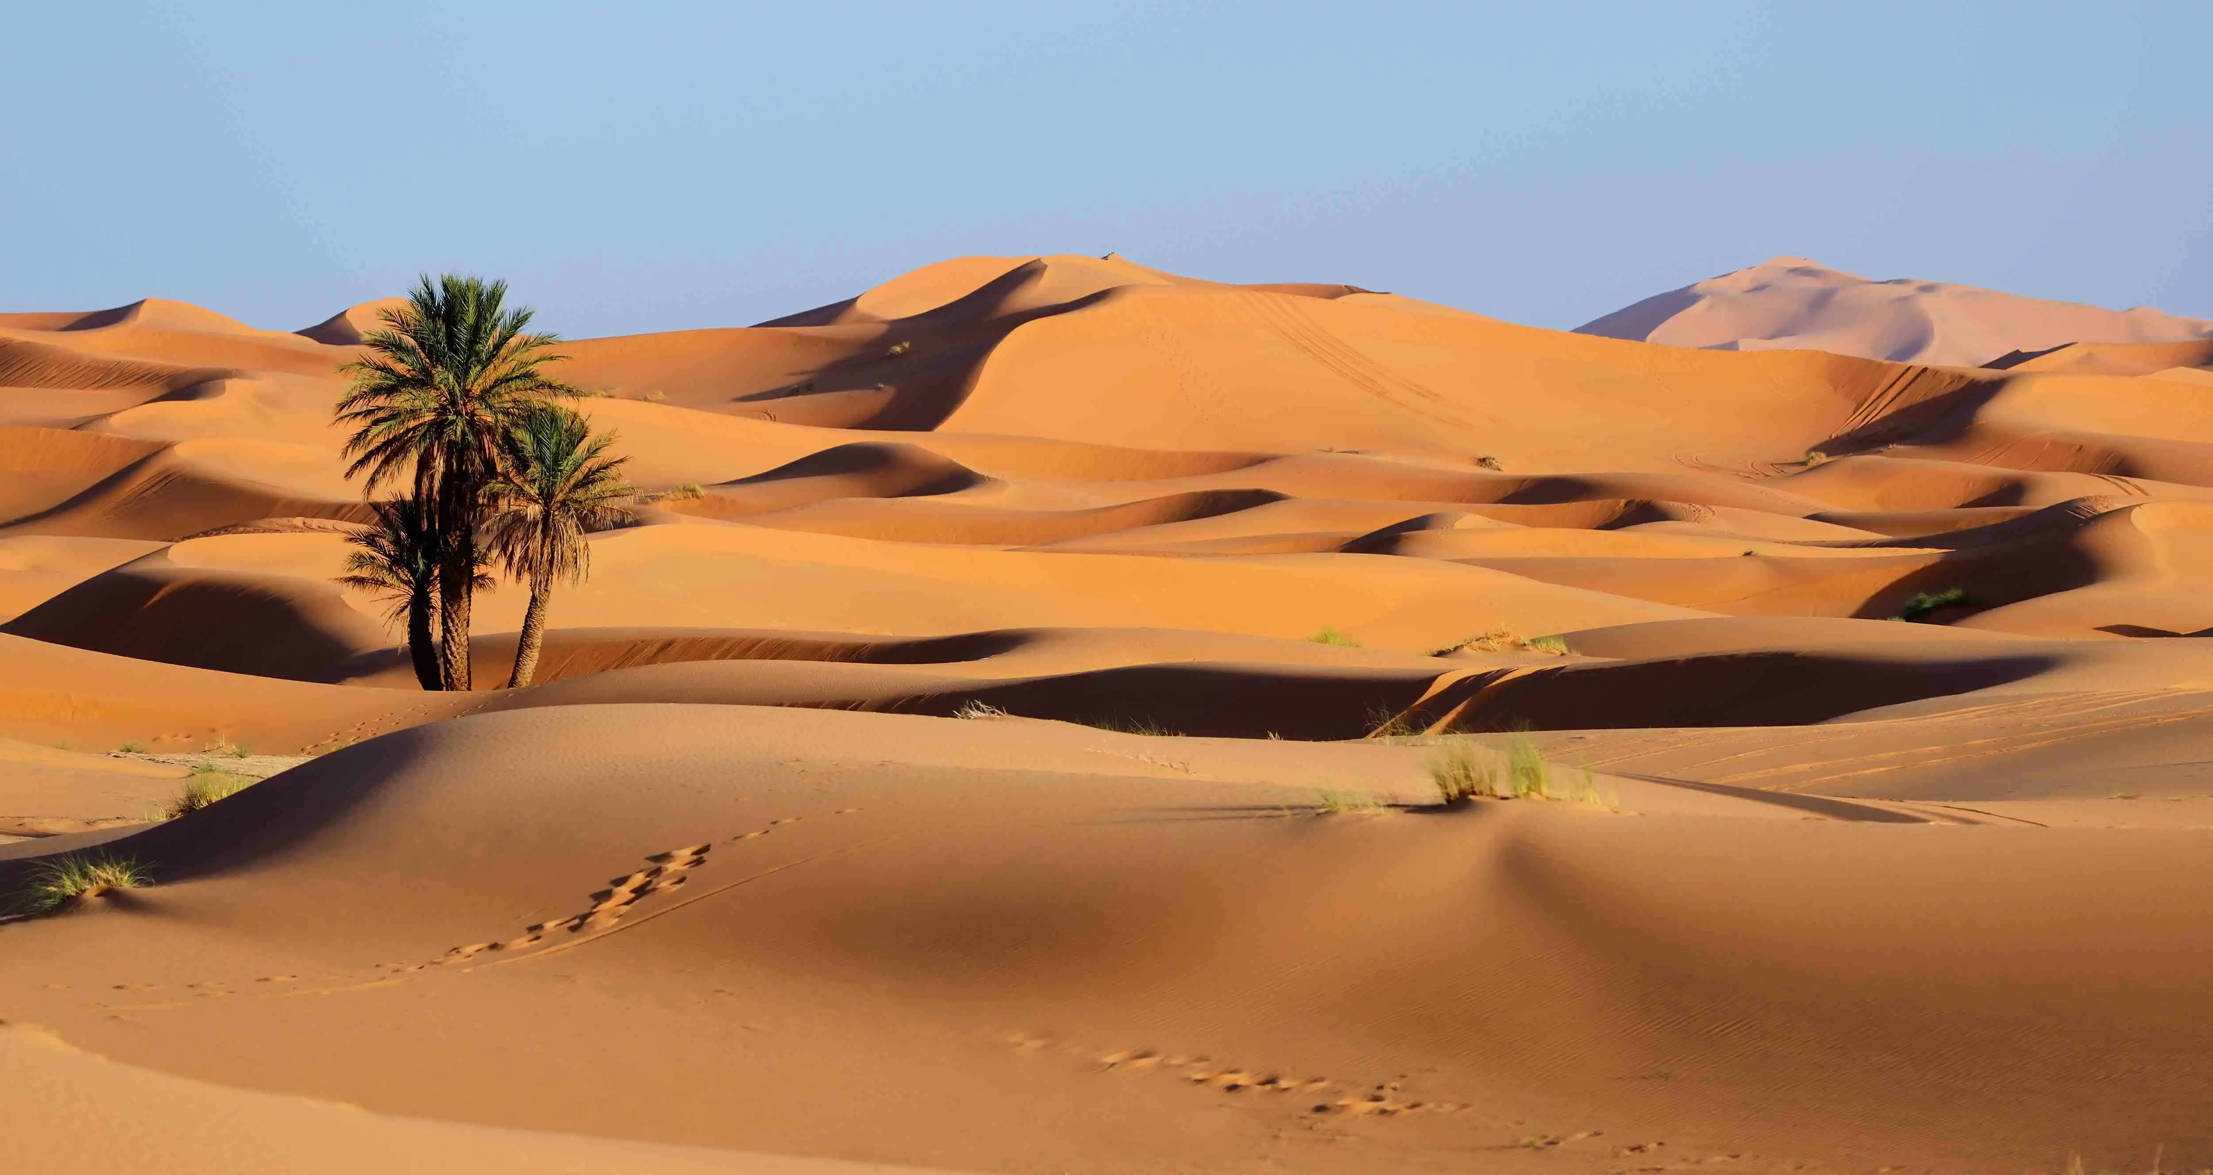
How can people change the world?
Key Vocabulary
compass | A tool which shows the directions north, south, east and west.
climate | The weather found in a certain place over a long period of time
desert | A place where there is a shortage of water for plants.
equality | Everyone has the same rights
prejudice | Thoughts about someone from a different background without a reason.
past | Having happened in an earlier time.
present | Is happening now.
future | Will happen in time to come.
Key Facts
The equator is halfway between the north pole and the south pole.
Hot countries are close to the equator and colder countries are further away.
All over the world, people have not been treated fairly just because of the colour of their skin, their religion or because they were a woman.
Rosa Parks said ‘no’ and would not give up her bus seat to a white person. Her brave step ended with the law being changed to make travel fair for everyone.
Rosa Parks

