Slide 1
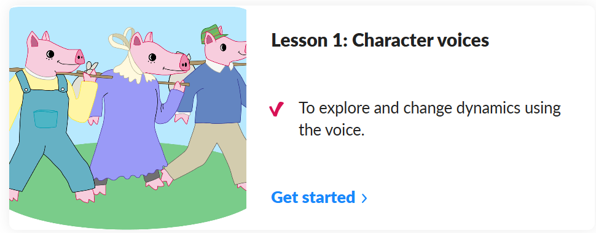


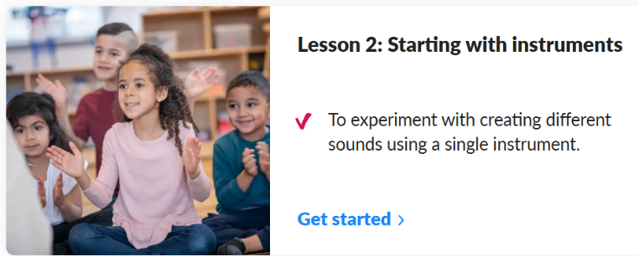

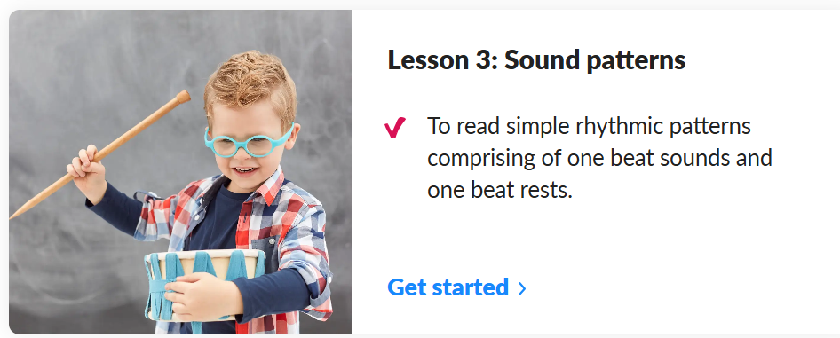
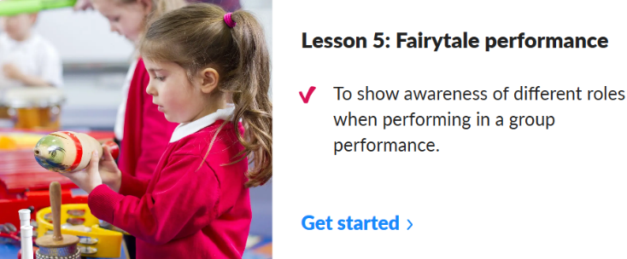
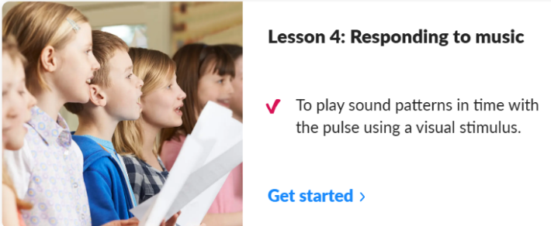
Spring 2: How can people change the world?
Lesson 1:
Peace and Conflict
Lesson 2:
Music – Sound patterns : Fairytales
Outcome: Create rhythmic patterns to tell a familiar fairytale.
Key concept: Understand rhythm.
Through fairytales, children are introduced to the concept of sound patterns (rhythms). They explore clapping along to repeated words and phrases, creating rhythmic patterns to tell a familiar fairytale.
Key knowledge: To know that sections of music can be described as loud, quiet or silent and the meaning of these terms.
Key vocabulary: character, voice, sound pattern
Lesson 3:
Lesson 5:
Lesson 4:

