Slide 1
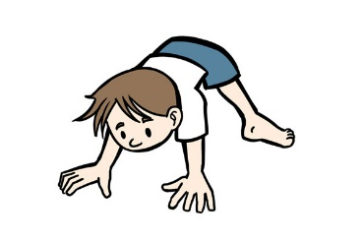
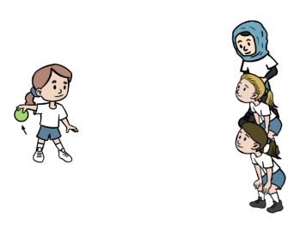
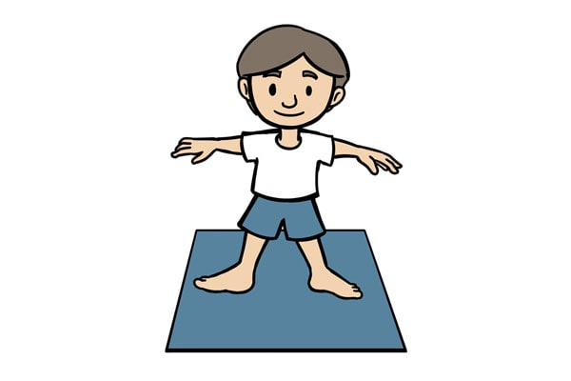
Spring 2: PE
Sending & Receiving
Gymnastics
Lesson 1:
To develop rolling and throwing a ball towards a target.
To explore travelling movements.
Lesson 2:
To develop receiving a rolling ball and tracking skills.
To develop quality when performing and linking shapes
PE: Sending and Receiving
Physical: rolling, kicking, throwing, catching, tracking
Social: taking turns, supporting and encouraging others, respect, communication
Emotional: challenging myself, perseverance, honesty, being happy to succeed
Thinking: transferring skills
PE: Gymnastics
Physical: travelling actions, shapes, balances, jumps, barrel roll, straight roll, forward roll progressions
Social: sharing, working safely
Emotional: confidence
Thinking: observing and providing feedback, selecting and applying
actions
Lesson 3:
To be able to send and receive a ball with your feet
To develop stability and control when performing balances
Lesson 4:
To develop throwing and catching skills over a short distance.
To develop technique and control when performing shape jumps.
Lesson 6:
To apply sending and receiving skills to small games.
To link gymnastic actions to create a sequence.
Lesson 5
To develop throwing and catching over a longer distance
To develop technique in the barrel, straight and forward roll.

