Slide 1
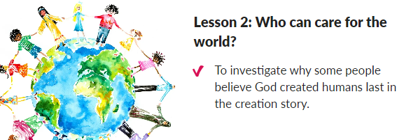
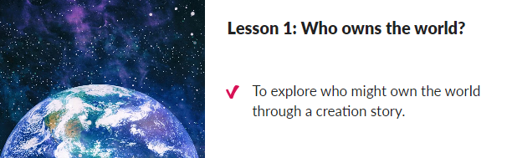

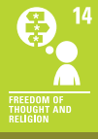
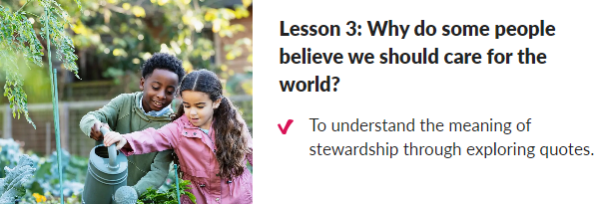

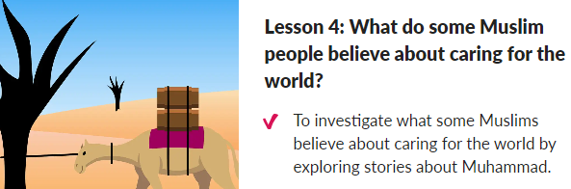
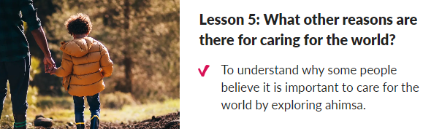
Spring 2: How can people change the world?
Lesson 1:
Lesson 2:
Peace and Conflict
RE: Why should we care for the world?
Outcome: Link to our litter campaign. Children will have a greater understanding and knowledge about caring for the local environment.
Key concept: Understand values
This concept involves an appreciation of how many people place values as an important aspect of their lives
Purpose: Building on their understanding of creation stories, children explore beliefs about the relationship between humans and nature
Lesson 3:
Lesson 4:
Lesson 5:

