Slide 1

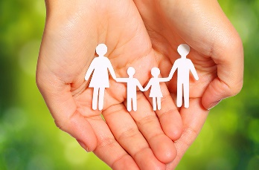

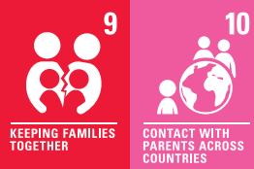
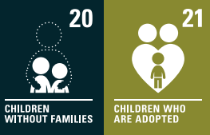

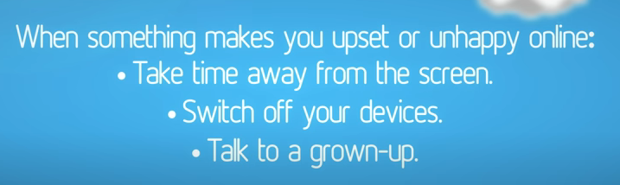
Spring 2: How can people change the world?
Lesson 1: We will think about who is in our family? A family is a special group of people which changes over time?
Lesson 2: We will learn about how our people in our family are connected in different ways and these connections are important.
Peace and Conflict
RHE: Fa1) Who’s in my family?
Os1) Screen time
Outcome: For children to understand the connections in their family.
For children to understand about the right amount of screen time and what we go online for.
Key concept:
Understand others
This concept involves an appreciation of others.
Connect
This concept involves developing an understanding of how to safely connect with others.
Purpose: write a happy family recipe.
Lesson 3: we will create a class recipe for a happy family.
A dollop of smiles
2) A sprinkle of hugs
3) 500g of kind words
Lesson 4: Screen time
What can happen if we spend too much time online? Can too much gaming affect our mood?
Lesson 5: Screen time
Red and Murphy: Screen Time and Mindfulness

