Slide 1
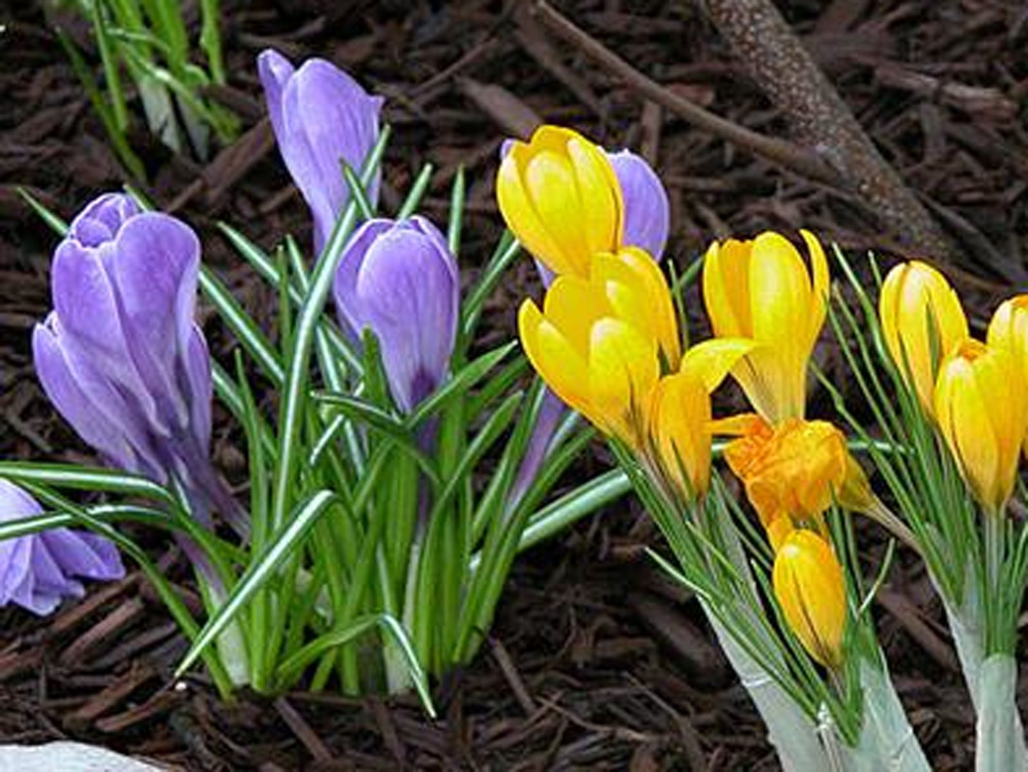

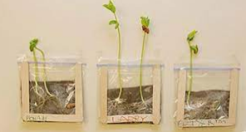

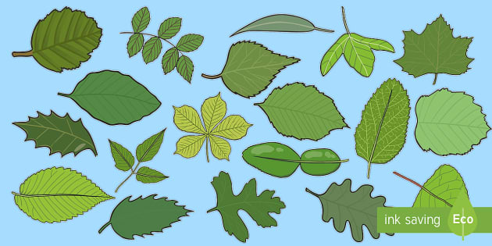
Spring 2: How can people change the world?
Lesson 1: We will begin an investigation to study the growth of a bean plant.
We will use magnifying glasses to study real flowers and draw their main parts.
Peace and Conflict
Lesson 2: We will learn the names of some common flowers and how to identify them. The children will understand that they are often wild plants. We will know the difference between wild, garden plants and weeds.
We will plant sunflower and think about how we need to care for them.
Science: Plants
Outcome:
The children will understand how plants grow and be able to name some common flowers and trees.
Key concept:
Understand plants
This concept involves becoming familiar with different types of plants, their structure and reproduction
Purpose:
We will grow sunflowers and some edible plants. We will taste the edible plants.
Lesson 3: We will learn the names of some common trees and whether they are deciduous or evergreen. We will look carefully at different leaf shapes and seeds.
We will plant some peas and potatoes.
Lesson 4: We will learn about the basic structure of some plants and trees. The children will be able to tell the difference between fruit and vegetable plants.
We will plant sunflower seeds.

