Slide 1



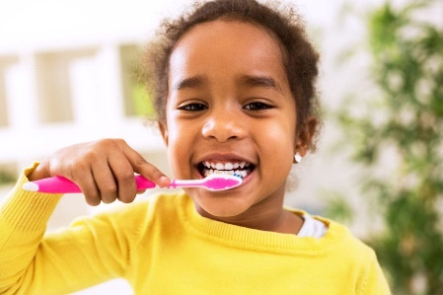

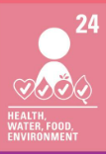
Week 1.
Personal information
We will have a more thorough and sophisticated understanding of personal information.
Week 2.
Personal information
We will understand that websites store a lot of our information.
Week 3.
Spreading Germs
We will understand the importance of hygiene, especially hand washing.
.
Year 3:
RHE
Os4) Personal Information [C2]
P3) How do I stop getting ill?
Week 4.
Oral hygiene: healthy teeth and mouths
We will understand how to keep our teeth healthy.
Week 5.
Sun Safety
We will understand the dangers of diseases caused by the sun how to stay safe from these.

