Slide 1
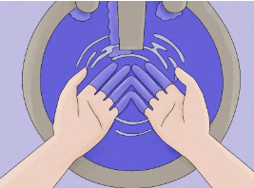

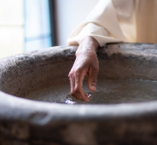
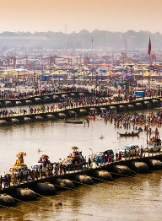
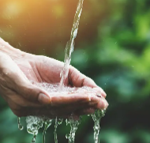


Week 1.
Why is water important?
We will explore why water is important to life, practically and symbolically.
Week 2.
How is water used in some rituals?
We will find out about the significance of water in rituals.
.
Week 3.
What do some religious stories suggest about water?
Next, we will analyse the importance of water in some Christian, Jewish and Muslim stories.
.
.
RE Year 3
Year 3:RE
Why is water symbolic?
Outcomes:
Making connections between religious stories and the importance of water.
Identifying how water is used in some rituals.
Suggesting what water might symbolise.
Making links between beliefs and actions.
Talking about why some Christians choose to be baptised.
Explaining water’s importance in religious and cultural contexts.
Sharing thoughtful insights or reflections on water’s importance.
Articulating their own ideas about the value of water creatively.
Week 4.
What is baptism?
Then, we will investigate water’s symbolism and role in various religious rituals.
Week 5.
How and why do some Hindus celebrate the River Ganges?
Finally, we will explore the significance of water at the Hindu Kumbh Mela festival.

