Slide 1

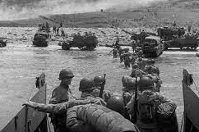
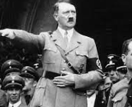
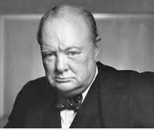
Knowledge Organiser: World War II in Europe
The Battle of Britain was the successful defense of Great Britain against the air raids conducted by the German air force in 1940 after the fall of France during World War II.
Key Vocabulary
World War II | The World War lasted from 1 September 1939 – 2 September 1945
Going into hiding | Many people were terrified of being taken away to camps or abused by the Nazis. They went into hiding so that they could not be caught, killed or imprisoned.
Camps | The Nazi party created camps to imprison, enslave and kill groups of people they hated, mostly Jewish people.
Neutral countries | Some European countries remained neutral which means that they did not take sides during World War II. These included – Sweden, Switzerland, Ireland.
Nazi Party | Hitler’s organisation in Germany. They believed that their race was better than others and tried to kill people who they did not value.
Axis | One of the two conflicting sides - Germany Japan and Italy were part of the Axis.
Allies | One of the two conflicting sides - led by the Soviet Union, United Kingdom, the United States and China.
Occupy / Invade | When one country takes over another country by force. The Nazis occupied many European countries.
Key Facts
D-day was the largest invasion force in human history. It was an international battle to win back France and other countries from the Axis. The Allies won.
60 million people lost their lives on the Allies side.
Modern day Europe now includes 44 countries. Europe was and still is the wealthiest continent.
The Second World War was triggered when Germany invaded Poland.
WWII started when Germany (the Nazi party) invaded Poland.
During World War II, the Prime Ministers for Britain were Neville Chamberlain and Winston Churchill.
Germany succeeded in invading our neighbouring countries – France, Denmark, Norway, Netherlands and Czechoslovakia (now Czechia and Slovakia).
20 million Russian people died trying to protect Russia from Nazi invasion. They were on the Allies side.
WWII started on 1st September, 1939. The war ended on 2nd September, 1945.
Did you know?
50-55 million people died in WWII. 6 million European Jewish people died.
Did you know?
Lots of people left Germany before the war started because they did not agree with the values of the Nazi parts.

Slide 2
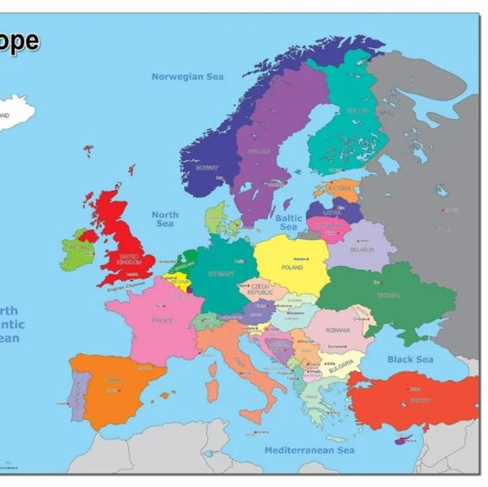
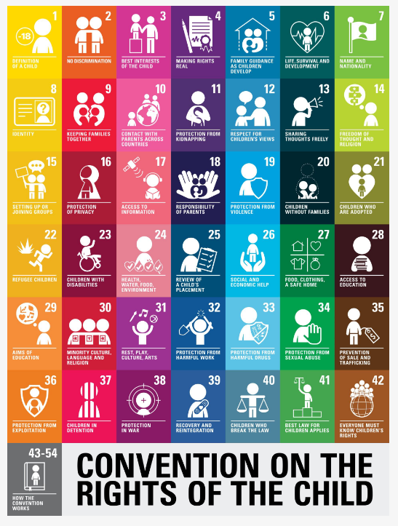
The control of the Atlantic Ocean was very important in World War II. The Allied and Axis powers both fought to control it. Great Britain and Russia wanted to control the Atlantic because it was an important route of supplies for the Soviet Union (Russia) and Britain in the fight against Germany and Italy
Many Jewish children had their rights denied to them during World War II.

