Slide 1



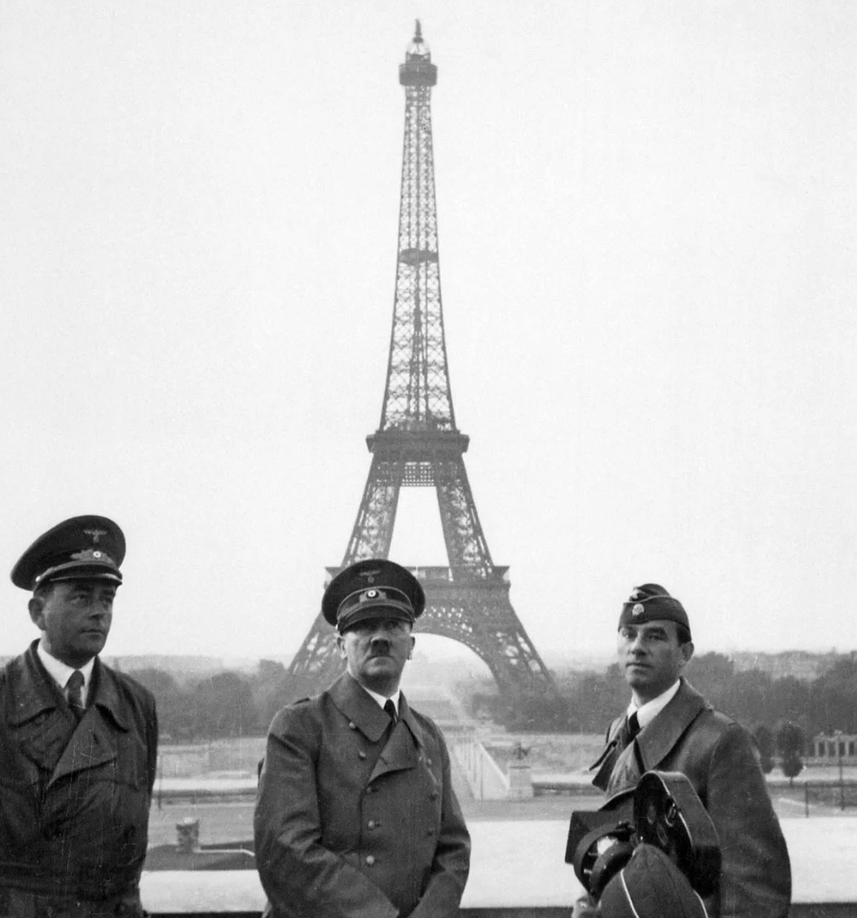



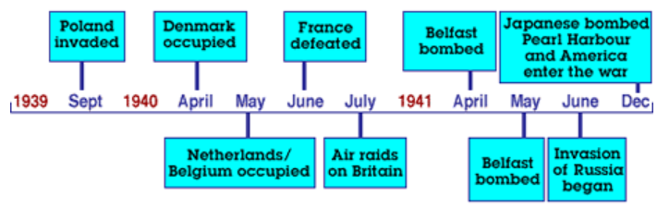




Week 1.Global Curriculum:
What does justice mean?
Is the world always equal and fair? How do we know?
History
What led up to the start of WW2? Had the Germans been treated fairly?
Week 2. History / Geography
We will explore further how and why Hitler invaded Poland.
We will research the economical and geographical advantages to the Axis and map the Axis’ occupation of European countries.
Week 3. History
We will find out about some of the values and aims of Nazi Germany. How was social justice denied? What happened to the Jewish people? What were the causes and consequences? Does this kind of oppression happen now?
Year 3:
Global theme: Social Justice and Equity
A study of an aspect or theme in British history that extends pupils’ chronological knowledge beyond 1066
How did Europe respond to invasion, threat and war?
Disciplinary Knowledge outcomes:
Use evidence to ask and answer questions about the past.
Use more than one source of evidence for historical enquiry in order to gain a more accurate understanding of history.
Describe different accounts of a historical event, explaining some of the reasons why the accounts may differ.
Describe characteristic features of the past, including ideas, beliefs, attitudes and experiences of men, women and children.
Place events, artefacts and historical figures on a timeline using dates.
Use dates and terms to describe events.
Use appropriate historical vocabulary.
Use literacy, numeracy and computer skills to a good standard in order to communicate information about the past.
Week 4. History
We will learn more about key events in the Second World War in Europe and their consequences with a focus on The Battle of Britain.
We will then build a class ‘animated’ or video timeline of the Second World War in chronological order.
Outcome:
An animated/video timeline of the
Second World War.
Week 5: History /Geography
We will recap the European countries on a map, recap the seas and sea features. We will then look at the importance of the sea during WWII.
Week 5. History
We will look at how VE Day came about and the celebrations which took place with street parties, dancing and music.

