Slide 1

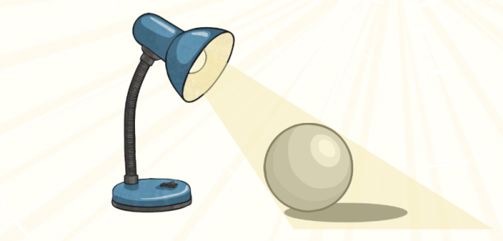
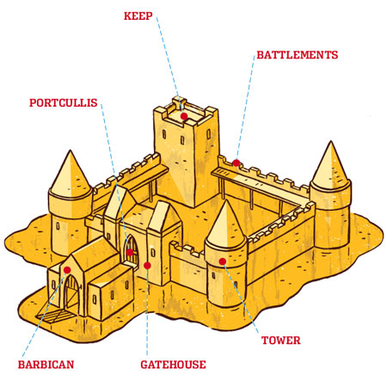

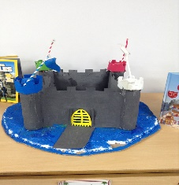
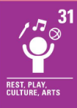
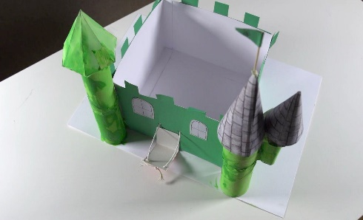
Week 1
To recognise how multiple shapes (2D and 3D) are combined to form a strong and stable structure. Look at the features of a castle.
Week 2
To follow a design specification to create a castle. To label your drawings with the shapes and subsequent nets and recyclable materials they will use to make it.
Year 3:
Design Technology
Week 3
To construct the nets to make 3D shapes to use in the construction of the castles.
Week 6
To write up the process of designing and creating a 3D castle including anything you would change if you did it again.
Outcome:
To design a castle with key features to appeal to a specific person/purpose.
To construct a 3D castle from recyclable objects.
Week 5
To make and attach specific features of your designs. Including decorating and adding facades to compete the project.
Week 4
To continue to make the nets and shapes for the castle and then begin to make and attach specific features of your designs. Including decorating and adding facades to compete the project.

