Slide 1
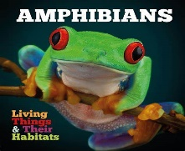
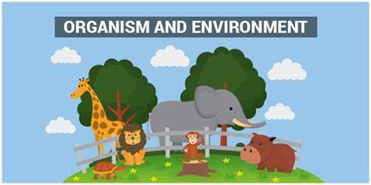
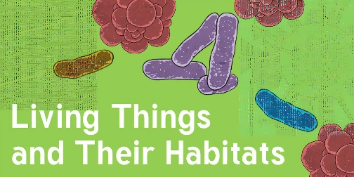
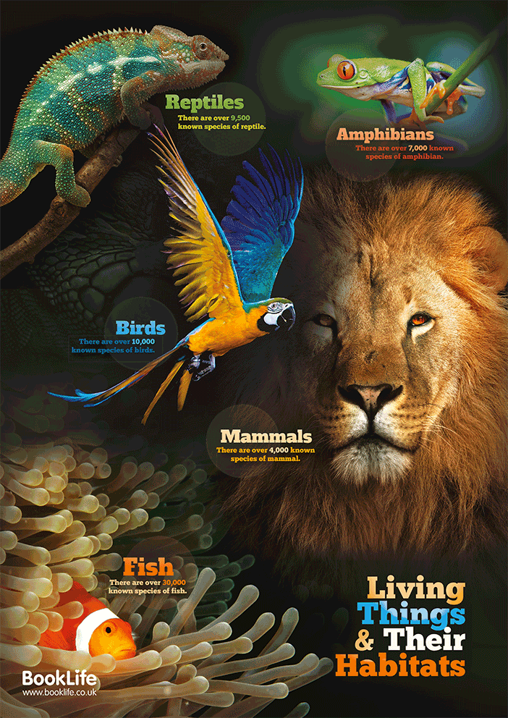
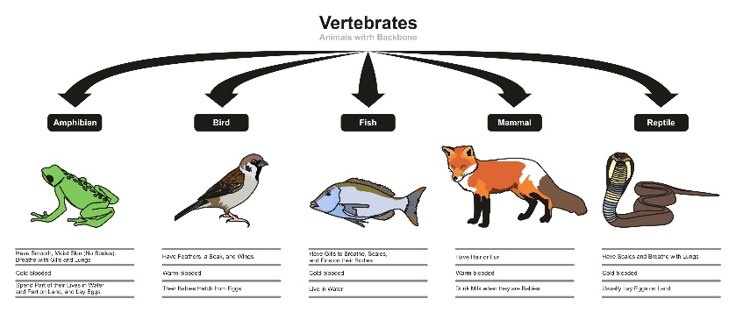
Knowledge Organiser: Living things and their habitats
Key Vocabulary
Organisms | This is another word that can be used to mean ‘living things’.
Life processes | The things living things do to stay alive.
Habitat | The specific area or place in which animals or plants may live.
Environment | An environment contains many habitats and these include areas where there are both living and non-living things.
Respiration | A process where plants and animals use oxygen gas from the air to help turn their food into energy.
Reproduction | The process through which young are produced.
Key Facts
Plants and animals rely on the environment to give them everything they need. When habitats change, it can be very dangerous to the plants and animals that live there.
Classification is the process of putting things into groups. Living things can be divided into these groups or classified by looking at similarities and differences between the way they look and behave.
Animals are divided into two main groups – vertebrates (have a spine) or invertebrates (have no spine).
A lifecycle is the different stages of life for all living things, including humans.
To stay alive and healthy, all living things need certain conditions that let them carry out key life processes.
Did you know?
Changes to an environment can be caused by humans. Changes to an environment can have a positive as well as negative effect.

