Slide 1
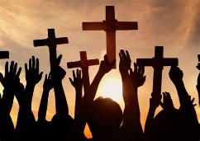

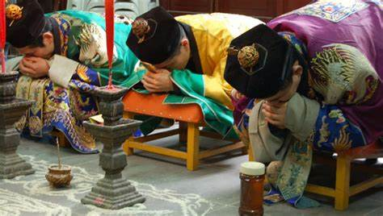
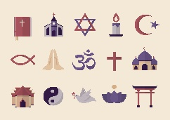
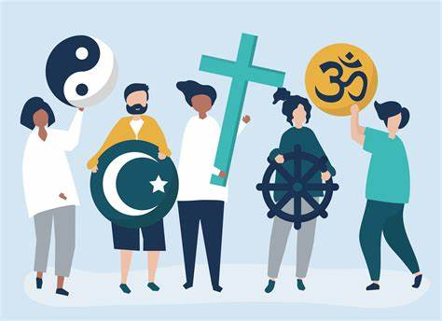
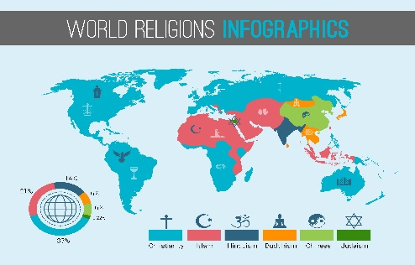
Knowledge Organiser: Are All Religions Equal?
Key Vocabulary
Equality | The state of been equal.
Guru | A Hindu spiritual teacher.
Merciful | Showing or exercising mercy.
Origin | The point or place where something begins, arises or is derived.
Harmony | The quality of forming a pleasing and consistent whole.
Omniscient | To know everything.
Key Facts
Islam is the second largest religion in the world with 1.9 million followers.
Christianity is the world’s most widespread, with 2.1 million Christians and about 34,000 Christian denominations in the world.
An estimated 1.2 billion people around the world do not follow any religion.
Each religion has its own unique set of beliefs and practises.
The Bible is the world's best-selling book, with about 50 copies sold every minute and over1 billion copies sold.
Did you know?
There are about 4,200 religions on Earth?

