Slide 1
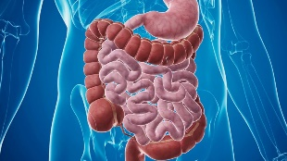
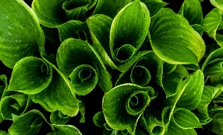
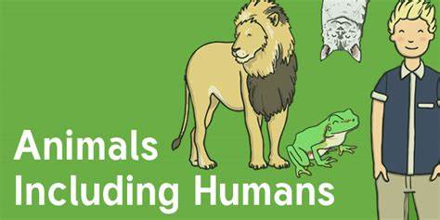
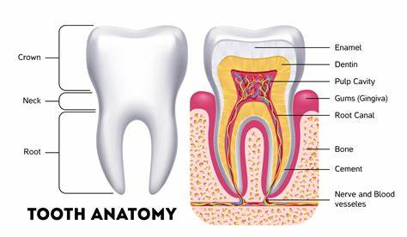
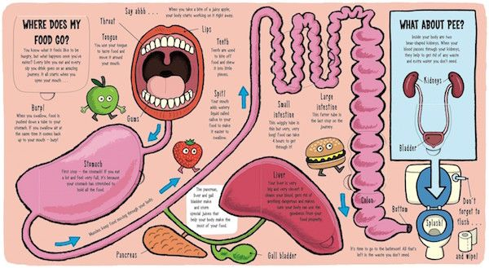
Knowledge Organiser: Animals including humans
Key Vocabulary
Digest | Break down food so it can be used by the body.
Oesophagus | A muscular tube which moves food from the mouth to the stomach.
Stomach | An organ in the digestive system where food is broken down with stomach acid and by being churned around.
Small Intestine | Part of the intestine where nutrients are absorbed into the body.
Large Intestine | Part of the intestine where water is absorbed from remaining waste food. Stools are formed in the large intestine.
Producer | A plant that produces its own food.
Key Facts
The main organs of the digestive system are the mouth, the pharynx, the oesophagus, the stomach, and the small and large intestines.
For every human in the world there are one million ants
Tooth enamel is the strongest substance in the human body and protects teeth from cavity-causing bacteria.
1.7 litres of saliva is produced each day.
The oesophagus is approximately 25cm long.
Did you know?
The muscles in the oesophagus act like a giant wave to move food or drinks down to the stomach.

