Slide 1
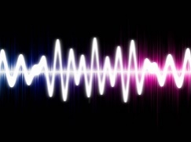
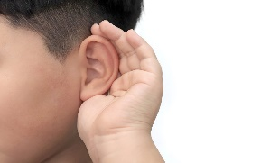
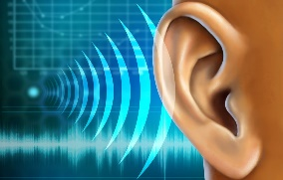

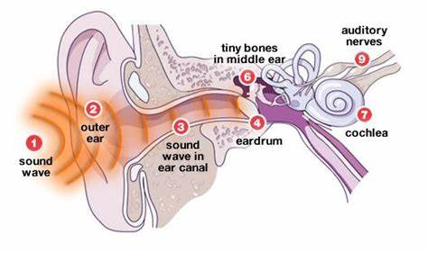
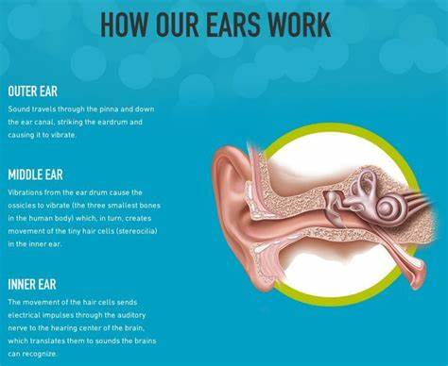
Knowledge Organiser: Sound
Key Vocabulary
Vibration | A quick movement back and forth.
Sound wave | Vibrations travelling from a sound source.
Volume | The loudness of a sound.
Amplitude | The size of a vibration. A larger amplitude = a louder sound.
Pitch | How high or low a sound is.
Particles | Solids, liquids and gases are made of particles. They are so small we are unable to see them.
Key Facts
Sound is a type of energy. Sounds are created by vibrations. The louder the sound, the bigger the vibration.
Dogs can hear sounds at a much higher frequency than humans can, this means dogs can hear sounds humans cannot.
We hear sounds that vibrate 20 and 20,000 times in a second.
Sound is used by many animals to detect danger, warning them of possible attacks before they happen.
Sound can travel four times faster in water.
Did you know?
There is no sound in space? This is because there are no molecules in space which is what sound needs to travel. Without any molecules sound cannot travel.

