Slide 1
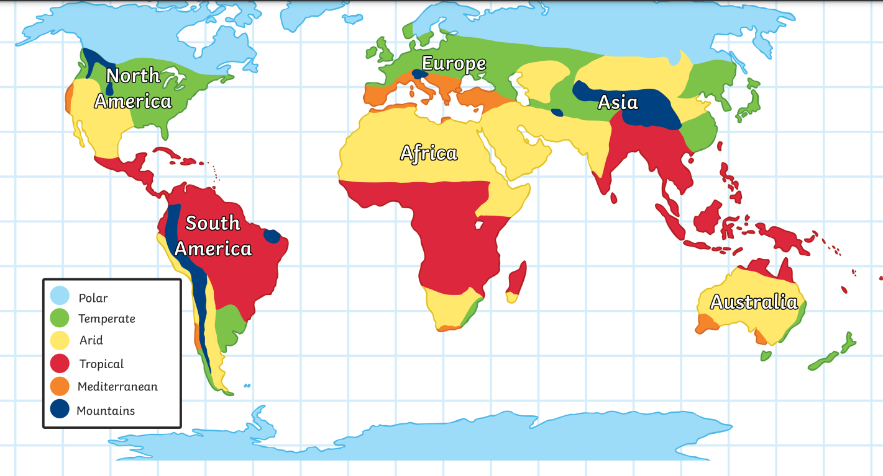
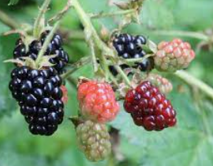
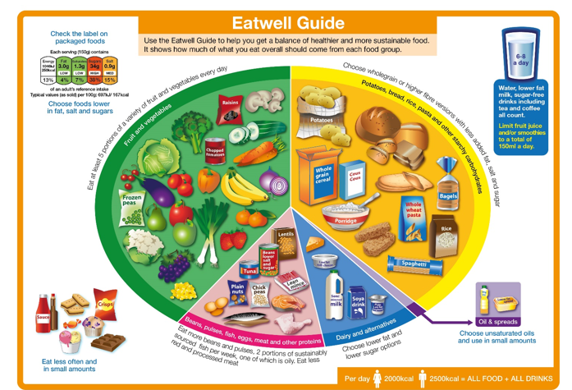
Nutrition: seasonal eating
Year 3
Food groups
First we will learn to recognise the components of a healthy diet and the foods that belong in the different food groups.
We will sort some kitchen cabinet foods into their groups and learn about how they help our bodies to grow and stay healthy.
Fruit detectives.
Next we will learn that fruits grow best in different climates and the food on our plates may have travelled around the world to reach us.
We will play ‘climate corners’ Where we touch, taste, sort and catagorize fruit grown in different climates. Linking with Geography learning to place them in their locations around the world.
Eating seasonally
After that we will explore the environmental impact of imported food and discover seasonal fruits and vegetables from the UK straight from the hedgerows, bushes and ground. We will find out about why and how people in the UK ‘Grow their own.’ and dig over the Year 1 garden, ready for spring-time planting.
Key Vocabulary:
Diet, imported, ingredients, food group, natural, seasonal, climate, protein, healthy,
carbohydrates, proteins, dairy, air miles.
Year 3:
Identity and Diversity.

