Slide 1
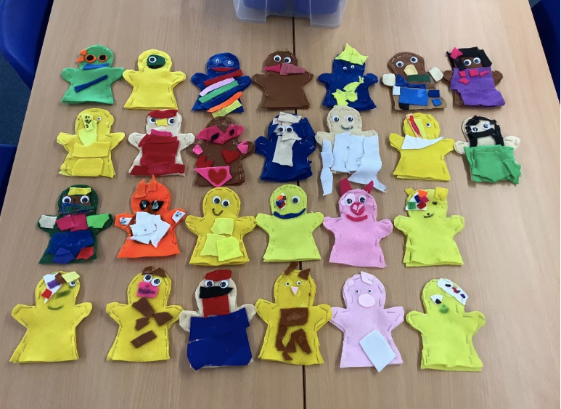
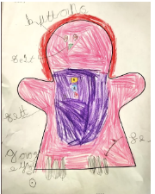
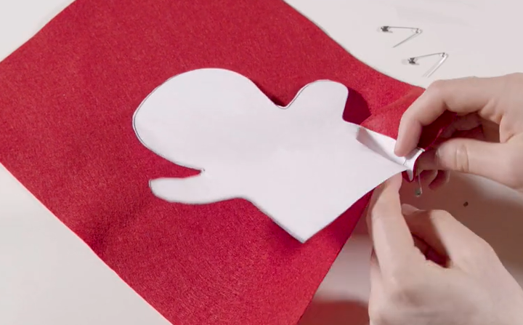
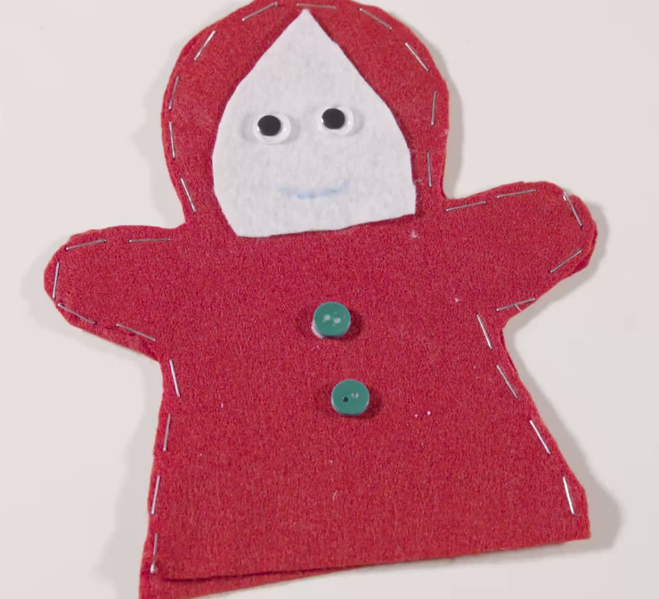
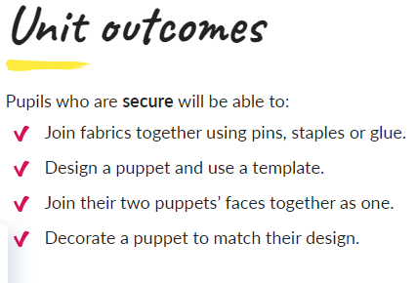

1. We will look at the story of Little Red Riding Hood to inspire our puppet designs. We will join felt fabric using three techniques: Pinning, Stapling and Glueing.
2. We will use a template to create our puppet design. Using scissors to cut out the felt fabric pieces for our puppet.
Spring 1 – DT
Joining techniques – creating a puppet.
3. We will carefully align the two pieces of fabric and choose our preferred method of joining (pinning, stapling or glueing) to connect the pieces of fabric together.
5. We will stand in a circle and look at others puppets saying what we like about each others’ puppets. We will then evaluate our own puppets.
4. We will use a range of materials to decorate our puppets based on one of the characters from the Little Red Riding Hood story. We will use different techniques to join the decorative pieces to our puppets.

