Slide 1
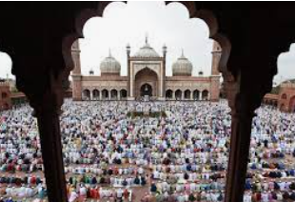

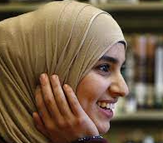
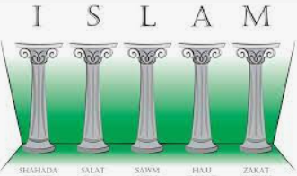

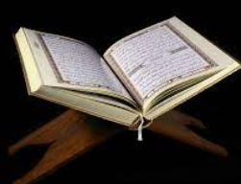
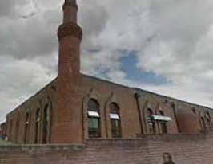
Week 1.
Introduction to Islam.
Explain where Islam was founded and who founded the Muslim faith. Explain the key beliefs of the Islamic faith including the 5 pillars of Islam.
Week 2.
Special Places.
Finding out about mosques. Draw, label and create a model of a mosque explaining the key features and why they are important to Muslims.
Week 3.
Special Festivals.
Name, describe and understand the importance of key festivals within the Islamic Faith. Create a group presentation about a festival.
Year 3:
Islam
.
Week 5.
Symbols and Meanings.
Discuss and compare symbols linked to different religions, how these symbols are used and why.
Create an artwork based on symbols associated with the Islamic faith.
Week 4.
Holy Book.
To learn about the Qur’an.
and explain how the words in the Qur’an were revealed to Muhammad in the Islamic Faith.
To discuss and record differences and similarities between Muslim beliefs about the Qur’an and those of other religions.

