Slide 1

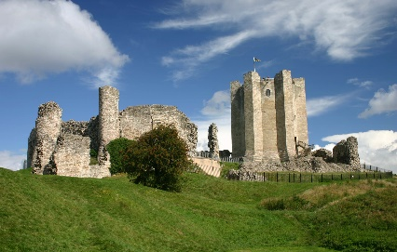
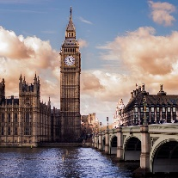
Year 1: Autumn 2
Is life always fair?
Outcome:
We will make a castle and re-enact a siege.
Week 1.
Geography: We will learn about England’s capital city- London. Where it is, it’s key landmarks, it’s significance in England. We will also learn about people, places and events you would typically see in London.
History: We will learn how
houses change through time.
Social Justice and Equity
Key Concepts:
Investigate places
This concept involves understanding the geographical location of places and their physical and human features.
Investigate and interpret the past
This concept involves understanding that our understanding of the past comes from an interpretation of the available evidence.
Build an overview of world history
This concept involves an appreciation of the characteristic features of the past and an understanding that life is different for different sections of society.
Understand chronology
This concept involves an understanding of how to chart the passing of time and how some aspects of history studied were happening at similar times in different places.
Week 2.
History: We will learn more about how the inside of houses have change over time. In particular our kitchen and living room. What are the gadgets we use to make life easier/ Have these always been the same?
Week 6.
We will finish the half term by learning about Christmas around the world. Finding on maps where the different countries are and how they celebrate Christmas.
Week 5.
The children will then learn about how the castle is defended. We will make armour and other equipment which is used to defend a castle. Finishing with a re-enactment of a castle siege.
Week 4.
We will learn about the life of rich and poor people during the medieval times.
We will compare their lives and think about whether it was fair.
Week 3.
We will learn about the location of Sheffield Castle and what still remains. We will about the structure of castles and why they were built in that way.
We will then build a castle out of boxes to show what we have learnt.

