Slide 1
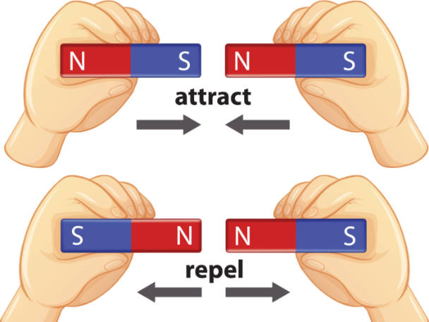
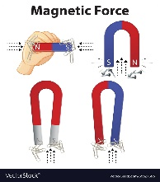


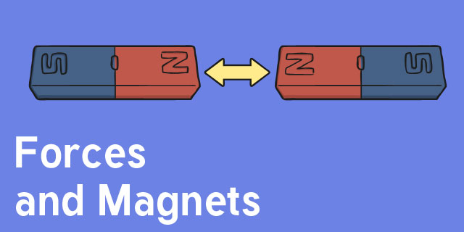
Week 1
We will discuss forces and what they are. Focus on push and pull forces and examples of these in the real world.
Week 2
To experiment using magnets and different materials.
Using magnets and testing these on different items in the classroom.
Year 3:
Opposites Attract
Forces and Magnets
Week 5
Assessment task
To create a two page spread showing our understanding of how to create a fair test and forces at work in the world.
Week 3
Enquiry/Investigation
To create a fair test to observe how magnets repel and attract each other.
How do magnets work with different materials?
Make a prediction – what will happen?
Outcome:
To understand what forces are focusing on magnets and how they work.
To create a fair test which will observe how magnets repel and attract each other including how magnets react to different materials.
Week 4
To present the data we recorded during our investigation by creating a written report explaining the steps we took and what happened.
What are we trying to find out?
What steps did we take?
How did we make it a fair test?

