Slide 1
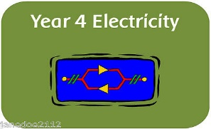
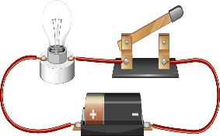

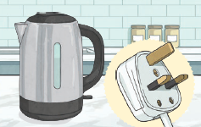
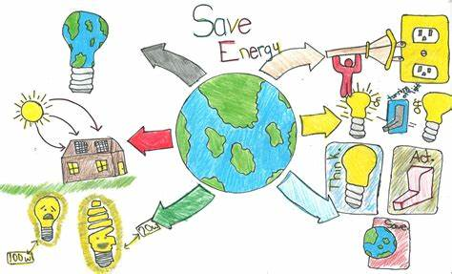
Knowledge Organiser: Electricity
Key Vocabulary
Electricity | The flow of an electric current through a material, e.g. from a power source through wires to an appliance.
Appliances | A piece of equipment or a device designed to perform a particular job, such as a washing machine or mobile phone.
Battery | A device that stores electricity energy as a chemical. Two or more cells joined together form a battery.
Circuit | A pathway that electricity can flow around. It is based around wires and a power supply.
Electrical insulator | Materials that are electrical insulators do not allow electricity to flow through it.
Electrical conductor | A conductor of electricity is a material that will allow electricity to flow through it.
Key Facts
Electricity is created by generators which can be powered by gas, coal, oil, wind or solar.
Electrical energy can be converted other types of energy such as light, heat, movement or sound.
Electricity is a form of energy that orders electrons into a flow capable of doing work on another object.
Electricity is measured in volts and electric current is measured in amps.
Electricity is very dangerous so we must be extra cautious when using electrical appliances.
Did you know?
Electricity travels at the speed of light (nearly 300,000km per second).

