Slide 1
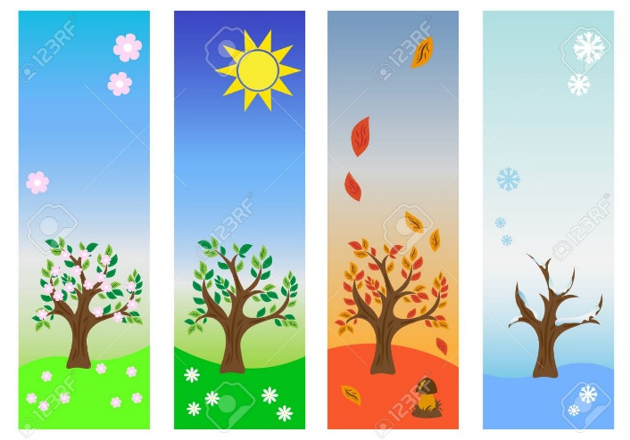
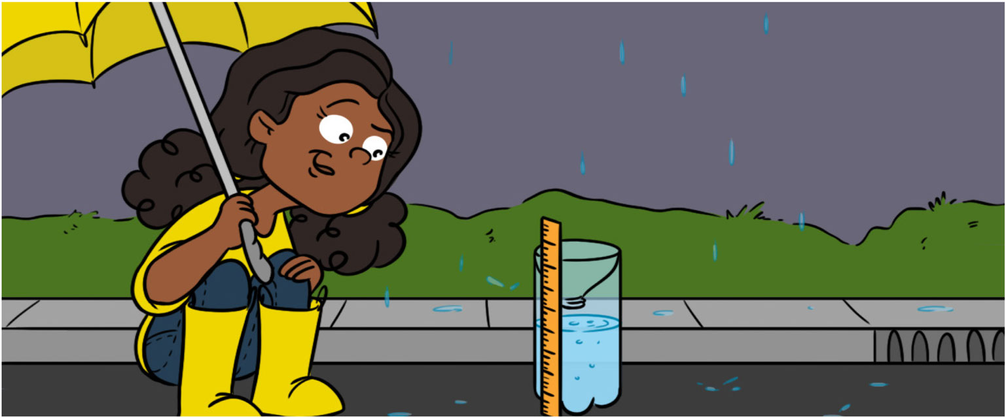

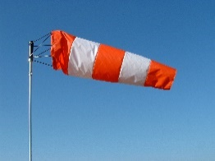
Year 1: Spring 1
Seasonal Changes
1.
Rain Gauge: science/ maths
We will ask questions about rainfall.
We will make a rain gauge to measure and record rain and snowfall over the next five weeks.
Weather diary:
We will observe and record today’s weather. We will compare it to previous weather diaries.
2.
Rain Gauge: science/ maths
We will measure the week’s rain and snowfall. We will record it in a chart.
Wind: science/ geography
We will ask questions about the wind.
We will make a wind sock to measure wind direction. We will measure the wind once a day for a week.
Outcome: We will create a mind map by drawing and writing everything we have learnt about the seasons.
.
5.
Rain Gauge: Science/ maths/ computing
We will measure the week’s rain and snowfall. We will compare the weeks’ results. We will create a chart on the computer.
Assessment:
We will create a mind map by drawing and writing everything we have learnt about the seasons.
4.
Rain Gauge: science/ maths
We will measure the week’s rain and snowfall. We will record it in a chart.
Ice Experiment:
We will observe what has happened to the ‘people’ stuck in the ice after the ice has been placed in 4 different locations.
3.
Rain Gauge: science/ maths
We will measure the week’s rain and snowfall. We will record it in a chart.
Wind: science/ geography
We will measure the wind direction every day using a compass. We will record it.
Ice Experiment:
We will ask questions about what will happen to the ‘people’ stuck in the ice.

