Slide 1

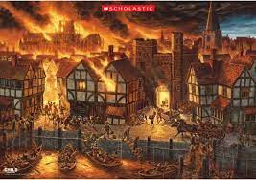





Week 1.
History: The Great Fire of London
We will look at the jobs that people had in the 17th Century and the differences between firefighting in the 17th Century and today.
We will then learn the key facts about the Great Fire of London.
Week 2.
Geography:
The children will locate London and the River Thames, and use compass directions to locate landmarks.
Week 3.
History: We will look at different sources. We will learn about Samuel Pepys and the significance of his diary.
Geography: We will locate key locations from the Great Fire on a map and use a map to show how the fire spread..
Year 2 Autumn 1: How can individuals change the lives of others?
Week 4.
Geography: We will look at maps and images of London before and after the fire. We will compare the human and natural features.
Social Justice and Equity
Key Concepts:
History:
Use artefacts, pictures, stories and online sources to find out about the past.
Describe historical events and significant people from the past.
Geography: Use basic geographical vocabulary to refer to human and natural features.
Ask and answer geographical questions.
Week 5.
History: We will put the key events from the Great Fire of London in order on a timeline.
Week 6.
History/ Computing/ Geography:
We will reflect upon the fire. What did people learn and how did this influence our lives today?
We will create videos explaining what we have learnt.
Outcome:
We will create videos explaining what we have learnt about the Great Fire of London and how this affected people’s lives.

