Slide 1

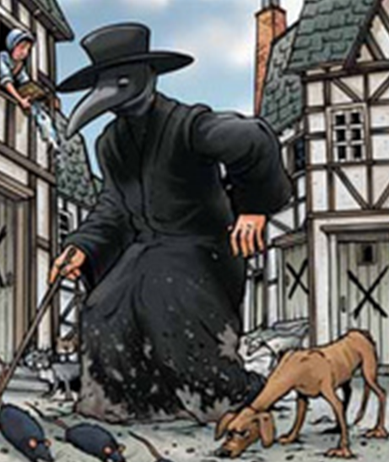





Week 1.
History: The Plague
We will learn about how people in the 1600s kept themselves clean and healthy and compare this with how people keep themselves clean and healthy today.
Week 2.
History:
We will look at the origins of the plague in the 1600s and previous outbreaks of the Black Death. We will learn about how the plague spread and the places that the plague spread to.
Week 3.
Geography:.
We will locate the places that the plague spread to on a map of the United Kingdom. We will discuss the directions the plague spread in and explain these using directional vocabulary.
Week 4.
History:.
We will learn how the plague came to London and how it spread there. We will use our knowledge of London in the 1600s to help us explain this.
Year 2 Summer 1: The Plague
Week 5.
History:
We will learn what Samuel Pepys wrote about the plague in his diary.
Power and Governance
Key Concepts:
History:
Use artefacts, pictures, stories and online sources to find out about the past.
Describe historical events and significant people from the past.
Geography: Use basic geographical vocabulary to refer to human and natural features.
Ask and answer geographical questions.
Week 6.
Geography:
We will locate Eyam on a map of the UK. Then on a map of Eyam, we will look at where the plague started and in which direction it spread.
Week 8.
History:
We will discuss our learning from our visit to Eyam. We will write up what we have learned about the plague came to Eyam, what happened as a result and how it ended.
Week 7.
History and Geography:
We will visit Eyam, looking at the houses where the plague started and where it spread to. We will also visit the church and the boundary stone and discover why these are significant.
Week 9.
History:
We will learn about how the plague ended and link this to our learning about the Great Fire of London.

