Slide 1
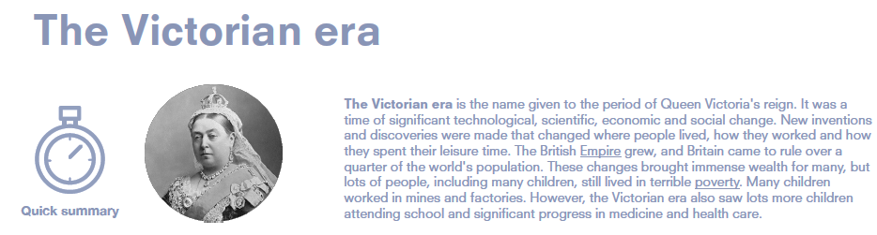
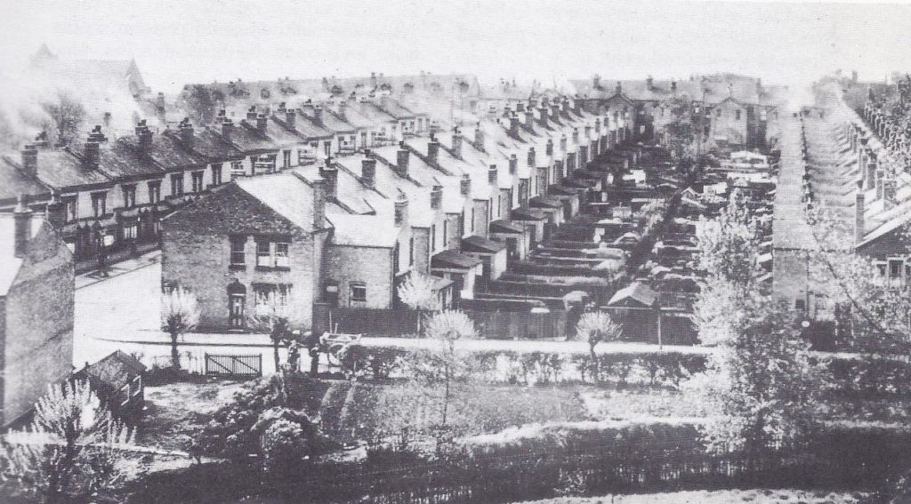
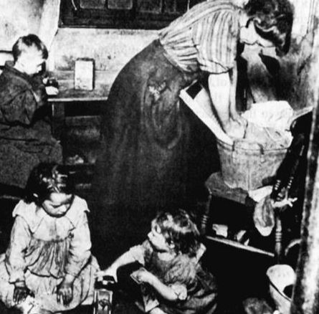
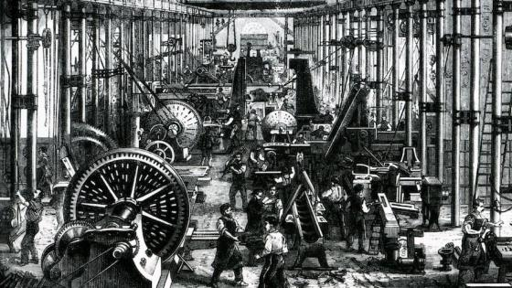
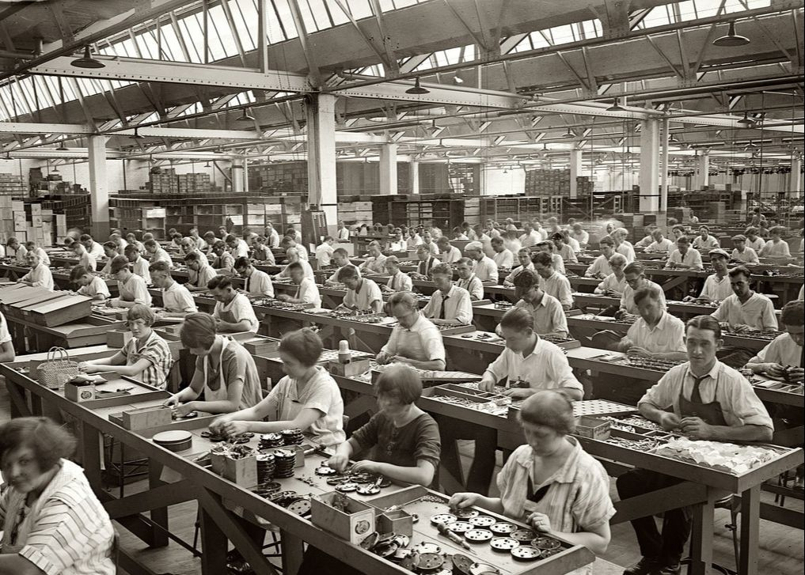
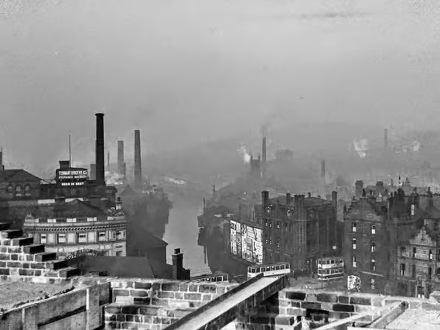
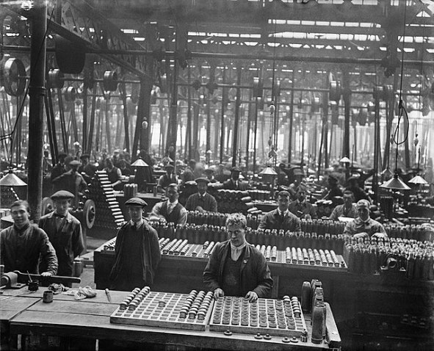
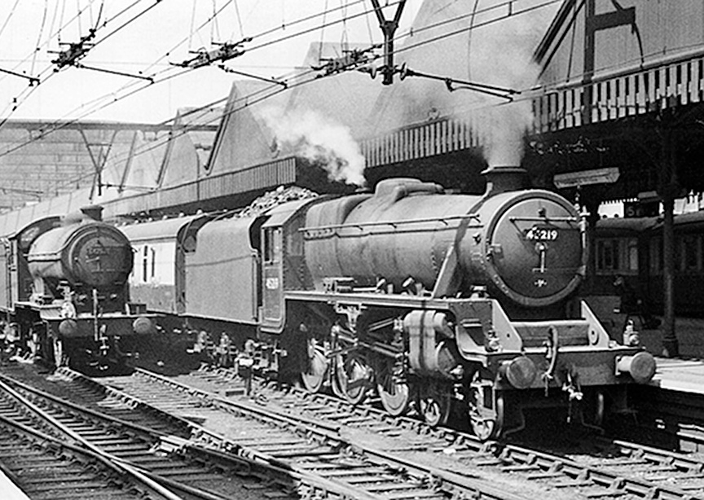
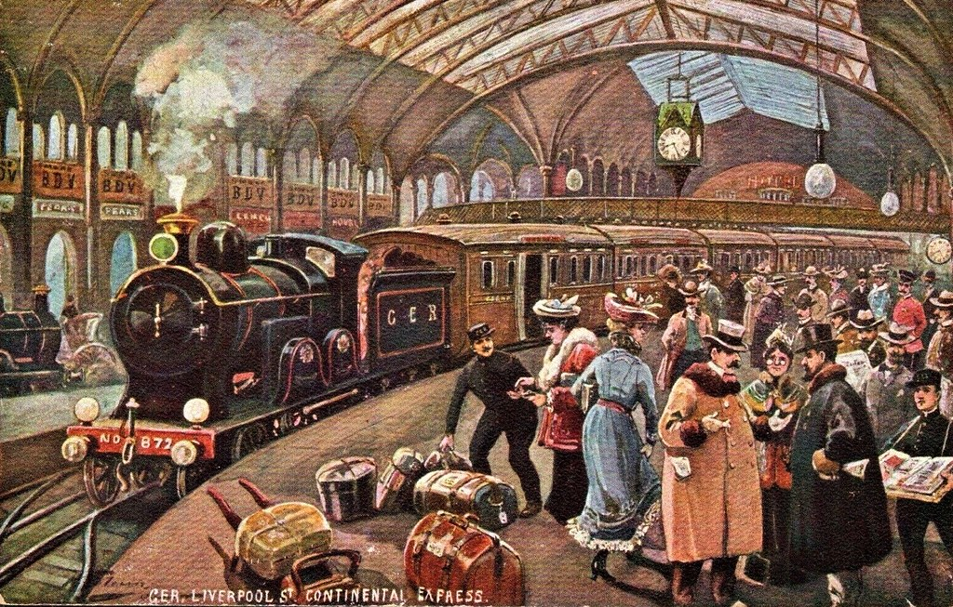
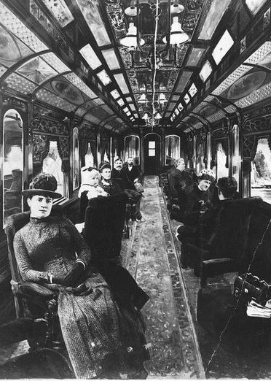
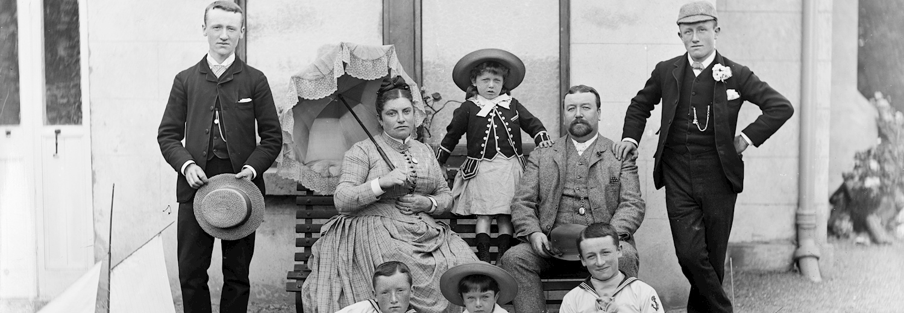
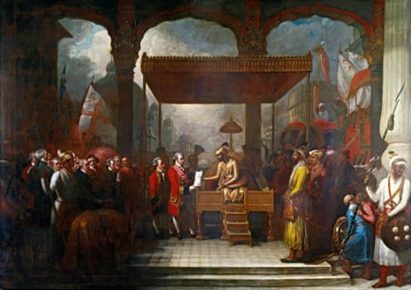
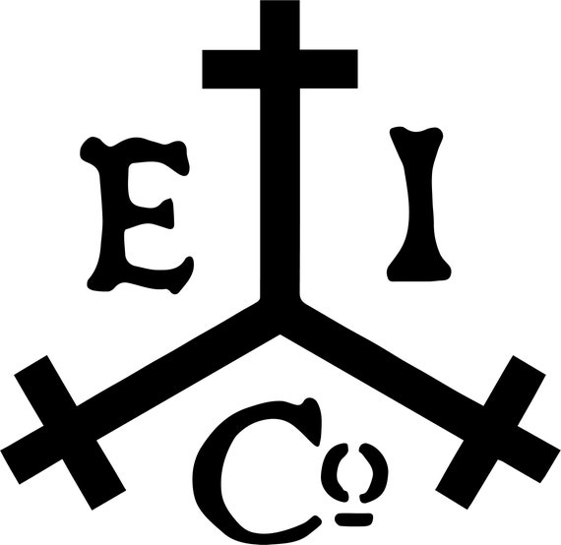
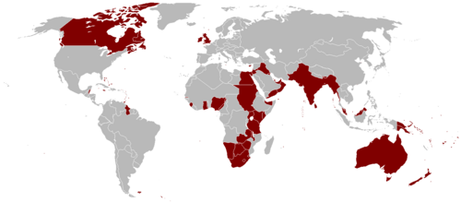
 | The number of people living in Britain more than doubled from 16 million to 37 million, causing a huge demand for food, clothes and housing.
 | Factories and machines were built to meet this demand and new towns grew up, changing the landscape and the ways people lived and worked.
 | Sheffield was an industrial city.
 | Railways, original built to transport goods, meant people could travel easily around the country for the first time.
 | Victorians lived in a hierarchy – all people were separated into classes: working class, middle class and upper class.
 | Britain used the East India Company to gain power over India and eventually colonised it.
 | Britain became the most powerful and richest country in the world with the largest empire that had ever existed, ruling a quarter of the world’s population.

